Slide 1

Saiful Adli Ismail

Slide 2
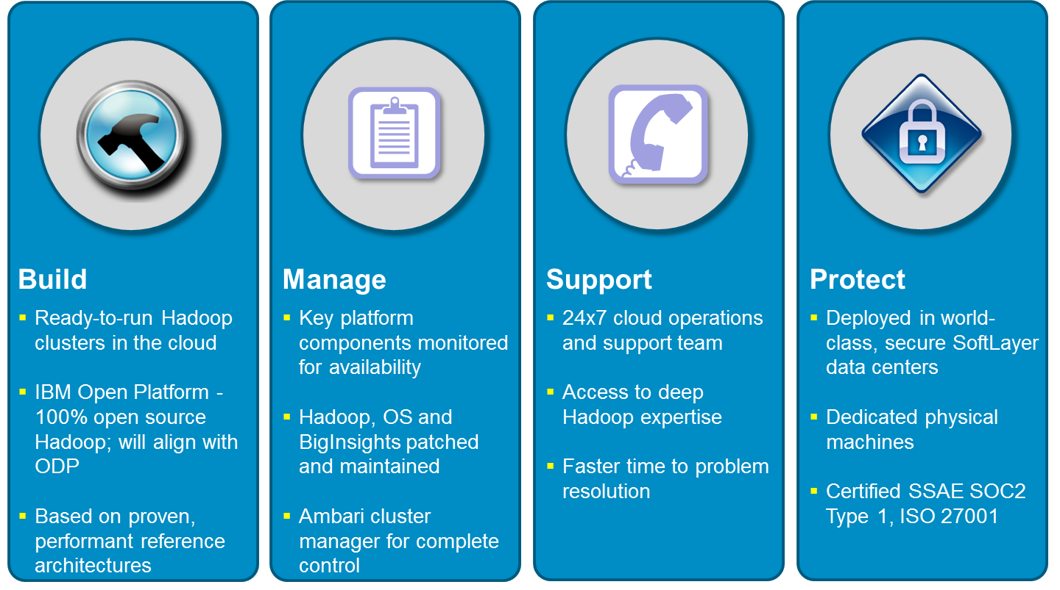
Cloud Offering - BigInsights for Apache Hadoop on SoftLayer

Slide 3
















Open Data Platform Initiative https://www.odpi.org
Why is IBM involved?
Strong history of leadership in open source & standards
Supports our commitment to open source currency in all future releases
Accelerates our innovation within Hadoop & surrounding applications
Open Data Platform (ODP) vs. Apache Software Foundation (ASF)
ODP supports the ASF mission
ASF provides a governance model around individual projects without looking at ecosystem
ODP aims to provide a vendor-led consistent packaging model for core Apache components as an ecosystem
All Standard Apache Open Source Components
HDFS
MapReduce
Spark
Hive
HCatalog
Pig
YARN
Ambari
HBase
Flume
Sqoop
Solr/Lucene
ODP

Slide 4

What is Spark?

Slide 5
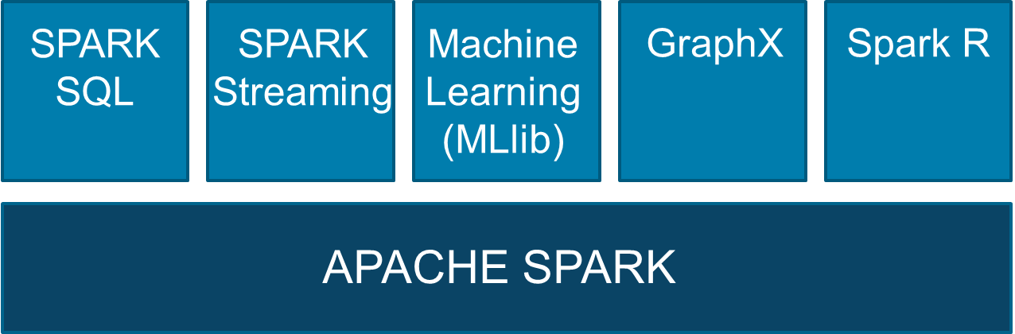
What is Spark?
Apache Spark is an open source project in Apache Software Foundation
Fast and general computing engine for clusters
Makes it easy and fast to process large datasets
API’s in Java, Python, Scala and R
Libraries in SQL, Streaming, Machine Learning,…
100x faster than MapReduce for some apps…
From
Data
Process
Result
= Big Bottleneck as Data Grows
Data
Process
Data
Process
Data
Data
Process
Result
To
Data
Process
Data
Process
Data
Process
Data
Process
Data
Process

Slide 6

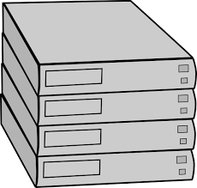

Spark Cluster Topology
Input Sources
Spark Cluster
Output Target
Multi node
Multiple Racks
Hadoop
Single Node
Programming Frameworks
Analytical Libraries
Analytical tools
Hadoop
Data Access
File System
Scala
Scala Shell
File System
RDBMS
RDD
MLlib
Python Shell
Python
RDBMS
S3
Data Frame
R Pkgs
R Shell
S3
Object Store
(Bluemix)
SparkR
Zeppelin
Object Store
(Bluemix)
SparkSQL
GrpahX
Jupyter
DashDB
Cloudant
(Bluemix)
DashDB
Cloudant
(Bluemix)
Standalone
Mesos
Hadoop/Yarn
Resource Manager
single node config, 1 Master and 1 Worker instance
Multi node and multi-rack configs could be configured with 1 or more Master, multiple Worker instances

Slide 7
Spark Components – core compute engine
Input Sources
Spark Cluster
Output Target
Spark Worker Node
Hadoop
Data Access
Programming Frameworks
Analytical Libraries
Analytical tools
Hadoop
File System
Scala
Scala Shell
File System
RDD
Spark Worker Node
RDBMS
Spark Master Node
Python
MLlib
Python Shell
RDBMS
S3
Data Frame
R Pkgs
R Shell
S3
Object Store
(Bluemix)
SparkR
Spark Worker Node
Zeppelin
Object Store
(Bluemix)
SparkSQL
GrpahX
Jupyter
DashDB
Cloudant
(Bluemix)
Spark Worker Node
DashDB
Cloudant
(Bluemix)
Standalone
Mesos
Hadoop/Yarn
Resource Manager
Spark can read and write to/from variety of data sources
Spark can run in Standalone mode or under Mesos or Hadoop/Yarn resource manager
Spark supports variety of programming frameworks with rich library support

Slide 8
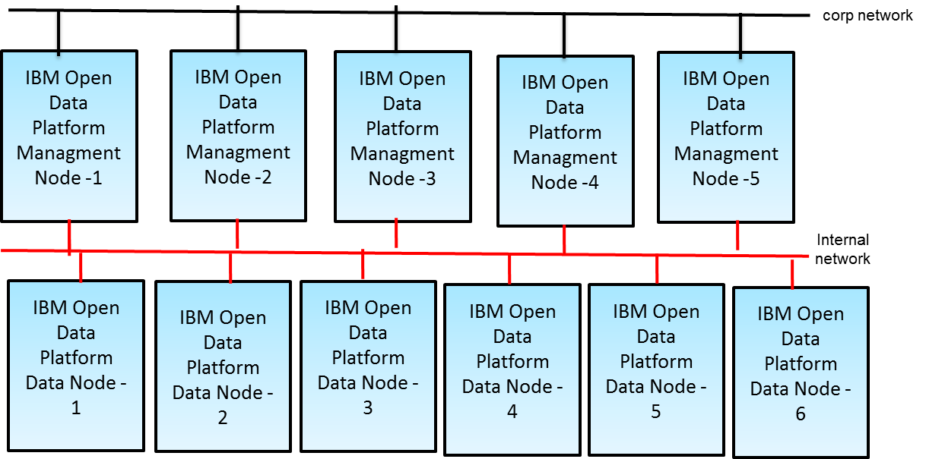
Spark Cluster – running in existing Hadoop cluster
Input Sources
Spark Cluster
Output Target
Hadoop
Data Access
Programming Frameworks
Analytical Libraries
Analytical tools
Hadoop
File System
Scala
Scala Shell
File System
RDBMS
RDD
MLlib
Python Shell
Python
RDBMS
S3
Data Frame
R Pkgs
R Shell
S3
Object Store
(Bluemix)
SparkR
Zeppelin
Object Store
(Bluemix)
SparkSQL
GrpahX
Jupyter
DashDB
Cloudant
(Bluemix)
DashDB
Cloudant
(Bluemix)
Standalone
Mesos
Hadoop/Yarn
Resource Manager
Spark Master services run on Management nodes of hadoop cluster
Spark Worker services run on data nodes of hadoop cluster
HA for Master node could be configured using Zookeeper to run on standby Management nodes

Slide 9
Spark Components and General Data Flow
Input Sources
Spark Cluster
Output Target
Hadoop
Data Access
Programming Frameworks
Analytical Libraries
Analytical tools
Hadoop
FileSystem
Scala
SparkSQL
Scala Shell
FileSystem
RDBMS
RDD
Python
MLlib
Python Shell
RDBMS
S3
Data Frame
R Shell
S3
Object Store
(Bluemix)
SparkR
Streaming
Zeppelin
Object Store
(Bluemix)
Java
GraphX
Jupyter
DashDB
Cloudant
(Bluemix)
DashDB
Cloudant
(Bluemix)
Standalone
Mesos
Hadoop/Yarn
Resource Managers
Spark can read and write to/from variety of data sources
Spark can run in Standalone mode or under Mesos or Hadoop/Yarn resource manager
Spark supports variety of programming frameworks with rich library support
Spark Components
External Data repositories
External Resource Managers

Slide 10

Spark Running in Standalone Mode
Spark SQL
Spark Streaming
GraphX
MLlib
SparkR
Apache Spark
Single node, with local storage
Resource management
Storage management
Compute layer

Slide 11


Spark on Hadoop
Spark SQL
Spark Streaming
GraphX
MLlib
SparkR
Apache Spark
Apache Hadoop-YARN
Resource management
Apache Hadoop-HDFS
Storage management
Slave node 1
Slave node 2
…
Slave node n
Compute layer

Slide 12
Spark in the Hadoop ecosystem
Currently, Spark is a general purpose parallel processing engine which integrates with YARN along the rest of the Hadoop frameworks
Map/
Reduce 2
Hive
Pig
Hbase
Spark
BigSQL
Impala
YARN
HDFS
Zooming on the red square…

Slide 13
Future of Spark’s role in Hadoop ?
The Spark Core engine is a good performant replacement for Map Reduce:
It will probably make sense for all frameworks generating Map Reduce to consider a port to Spark as the new underlying engine (Hive, Analytic engines: Machine learning and Big R, BigSheets, etc…)
Please note that this is not true for BigSQL which already uses DB2 as the underlying engine
Ditto for application frameworks for developers
BigSQL
Spark
SQL
Spark
MLlib
Spark
Streaming
Hive
Big R
Custom
M/R
BigSheets
Spark Core
YARN
HDFS

Slide 14
Spark – deeper dive

Slide 15
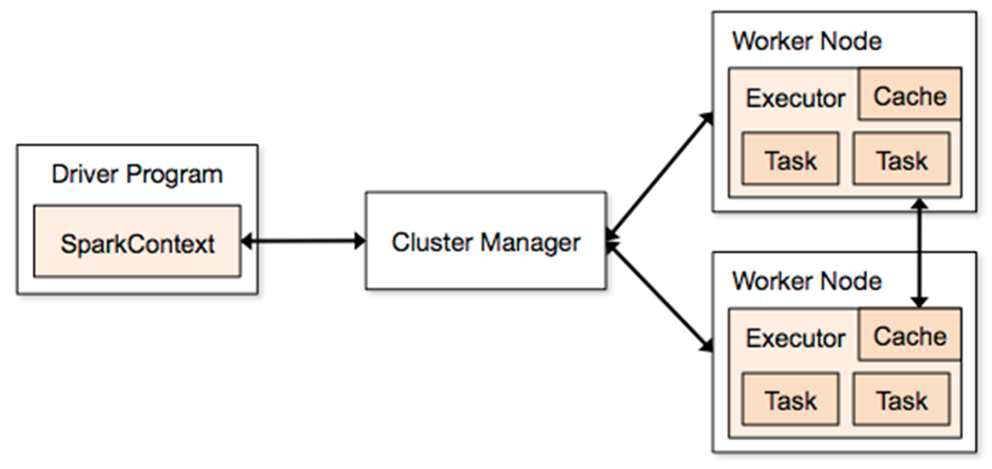
Spark Application Architecture
A Spark application is initiated from a driver program
Spark execution modes:
Standalone with the built-in cluster manager
Use Mesos as the cluster manager
Use YARN as the cluster manager
Standalone cluster on Amazon EC2

Slide 16
Spark Terminology
Context (Connection):
Represents a connection to the Spark cluster. The Application which initiated the context can submit one or several jobs, sequentially or in parallel, batch or interactively.
Driver (Coordinator agent)
The program or process running the Spark context. Responsible for running jobs over the cluster and converting the App into a set of tasks
Job (Query / Query plan):
A piece of logic (code) which will take some input from HDFS (or the local filesystem), perform some computations (transformations and actions) and write some output back.
Stage (Subplan)
Jobs are divided into stages
Tasks (Sub section)
Each stage is made up of tasks. One task per partition. One task is executed on one partition (of data) by one executor
Executor (Sub agent)
The process responsible for executing a task on a worker node

Slide 17
In a parallel DBMS things work quite the same
Application
Coordinator / Head Node
Query
Query
Sub Agents
Sub Agents
Sub Agents
Sub
section
Sub
section
Sub
section
Sub
section
Sub
section
Sub
section

Slide 18
Parallels in terminology between Spark and another big data parallel processing framework: BigSQL
Spark | DBMS (DB2 / BigSQL)
Spark Application / Spark Context | Connection
Spark driver (1 per App) | Coordinator agent
Spark App Master (1 per App) | Coordinator agent
Job (App runs several jobs) | Query / Query plan
Stage (Job has several stages) | Query subplan
Task (Stage has one task per partition) | Section / Sub-section
Executor (JVM instance on a slave node serving ONE app). Executes tasks | Dedicated subagent process (which will fork threads to execute sub sections)

Slide 19
Spark Components and General Data Flow
Input Sources
Spark Cluster
Output Target
Hadoop
Data Access
Programming Frameworks
Analytical Libraries
Analytical tools
Hadoop
FileSystem
Scala
SparkSQL
Scala Shell
FileSystem
RDBMS
RDD
Python
MLlib
Python Shell
RDBMS
S3
Data Frame
R Shell
S3
Object Store
(Bluemix)
SparkR
Streaming
Zeppelin
Object Store
(Bluemix)
Java
GraphX
Jupyter
DashDB
Cloudant
(Bluemix)
DashDB
Cloudant
(Bluemix)
Standalone
Mesos
Hadoop/Yarn
Resource Managers
Spark can read and write to/from variety of data sources
Spark can run in Standalone mode or under Mesos or Hadoop/Yarn resource manager
Spark supports variety of programming frameworks with rich library support
Spark Components
External Data repositories
External Resource Managers

Slide 20
Resilient Distributed Datasets
An RDD is a distributed collection of Scala/Python/Java objects of the same type:
RDD of strings
RDD of integers
RDD of (key, value) pairs
RDD of class Java/Python/Scala objects
It can help to think of an RDD as a view
An RDD is physically distributed across the cluster, but manipulated as one logical entity:
Spark will “distribute” any required processing to all partitions where the RDD exists and perform necessary redistributions and aggregations as well.
Example: Consider a distributed RDD “Names” made of names
Partition 1
Partition 2
Partition 3
Names
Mokhtar
Jacques
Dirk
Cindy
Dan
Susan
Dirk
Frank
Jacques

Slide 21
Resilient Distributed Datasets
Suppose we want to know the number of names in the RDD “Names”
User simply requests: Names.count()
Spark will “distribute” count processing to all partitions so as to obtain:
Partition 1: Mokhtar(1), Jacques (1), Dirk (1) ➔ 3
Partition 2: Cindy (1), Dan (1), Susan (1) ➔ 3
Partition 3: Dirk (1), Frank (1), Jacques (1) ➔ 3
Local counts are subsequently aggregated: 3+3+3=9
To lookup the first element in the RDD: Names.first()
To display all elements of the RDD: Names.collect() (careful with this)
Names
Partition 1
Partition 2
Partition 3
Mokhtar
Jacques
Dirk
Cindy
Dan
Susan
Dirk
Frank
Jacques

Slide 22
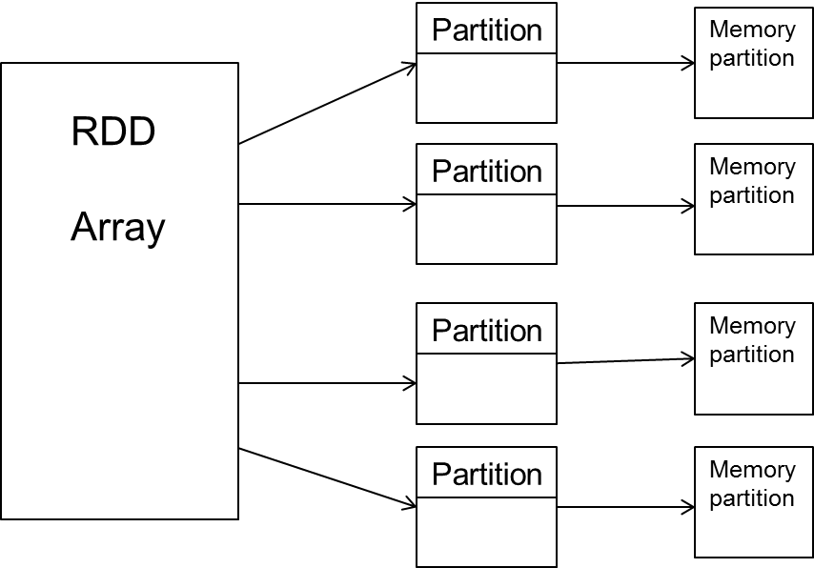
Resilient Distributed Datasets (RDD)
RDDs are immutable
Modifications create new RDDs
Holds references to partition objects
Each partition is a subset of the overall data
Partitions are assigned to nodes on the cluster
Partitions are in memory by default
RDDs keep information on their lineage

Slide 23
Resilient Distributed Datasets
Three methods for creation
Distributing a collection of objects from the driver program (using the parallelize method of the spark context)
val rddNumbers = sc.parallelize(1 to 10)
val rddLetters = sc.parallelize (List(“a”, “b”, “c”, “d”))
Loading an external dataset (file / table)
val quotes = sc.textFile("hdfs:/sparkdata/sparkQuotes.txt")
Transformation from another existing RDD
val rddNumbers2 = rddNumbers.map(x=> x+1)

Slide 24
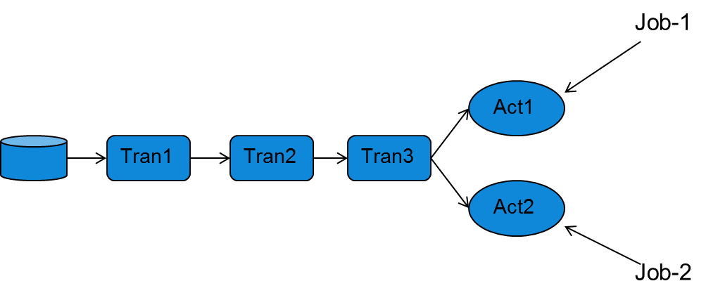
Spark Programming Model
Operations on RDDs (datasets)
Transformation
Action
Transformations use lazy evaluation
Executed only if an action requires it
An application consist of a directed acyclic graph (DAG)
Each action results in a separate batch job
Parallelism is determined by the number of RDD partitions

Slide 25
Spark Operations
Transformation operations (set operations)
Convert RDDs into other RDDs
Operations availability depends on the type of RDD processed
Example of operations:
Action operations
Return a value to the driver
Example of actions:
map | filter | flatMap | mapPartitions
union | intersection | distinct | groupByKey
reduceByKey | aggregateByKey | sortByKey | join
sample | pipe | cogroup | cartesian
reduce | collect | count | first
take | saveAsTextFile | countByKey | foreach

Slide 26
Code Execution (1)
‘spark-shell’ provides Spark context as ‘sc’
// Create RDD
val quotes = sc.textFile("hdfs:/sparkdata/sparkQuotes.txt")
// Transformations
val danQuotes = quotes.filter(_.startsWith("DAN"))
val danSpark = danQuotes.map(_.split(" ")).map(x => x(1))
// Action
danSpark.filter(_.contains("Spark")).count()
File: sparkQuotes.txt
DAN Spark is cool
BOB Spark is fun
BRIAN Spark is great
DAN Scala is awesome
BOB Scala is flexible

Slide 27
Code Execution (2)
// Create RDD
val quotes = sc.textFile("hdfs:/sparkdata/sparkQuotes.txt")
// Transformations
val danQuotes = quotes.filter(_.startsWith("DAN"))
val danSpark = danQuotes.map(_.split(" ")).map(x => x(1))
// Action
danSpark.filter(_.contains("Spark")).count()
File: sparkQuotes.txt
RDD: quotes
DAN Spark is cool
BOB Spark is fun
BRIAN Spark is great
DAN Scala is awesome
BOB Scala is flexible

Slide 28
Code Execution (3)
// Create RDD
val quotes = sc.textFile("hdfs:/sparkdata/sparkQuotes.txt")
// Transformations
val danQuotes = quotes.filter(_.startsWith("DAN"))
val danSpark = danQuotes.map(_.split(" ")).map(x => x(1))
// Action
danSpark.filter(_.contains("Spark")).count()
File: sparkQuotes.txt
RDD: quotes
RDD: danQuotes
DAN Spark is cool
BOB Spark is fun
BRIAN Spark is great
DAN Scala is awesome
BOB Scala is flexible

Slide 29
Code Execution (4)
// Create RDD
val quotes = sc.textFile("hdfs:/sparkdata/sparkQuotes.txt")
// Transformations
val danQuotes = quotes.filter(_.startsWith("DAN"))
val danSpark = danQuotes.map(_.split(" ")).map(x => x(1))
// Action
danSpark.filter(_.contains("Spark")).count()
File: sparkQuotes.txt
RDD: quotes
RDD: danQuotes
RDD: danSpark
DAN Spark is cool
BOB Spark is fun
BRIAN Spark is great
DAN Scala is awesome
BOB Scala is flexible

Slide 30
Code Execution (5)
// Create RDD
val quotes = sc.textFile("hdfs:/sparkdata/sparkQuotes.txt")
// Transformations
val danQuotes = quotes.filter(_.startsWith("DAN"))
val danSpark = danQuotes.map(_.split(" ")).map(x => x(1))
// Action
danSpark.filter(_.contains("Spark")).count()
File: sparkQuotes.txt
RDD: quotes
RDD: danQuotes
RDD: danSpark
DAN Spark is cool
BOB Spark is fun
BRIAN Spark is great
DAN Scala is awesome
BOB Scala is flexible
DAN Spark is cool
BOB Spark is fun
BRIAN Spark is great
DAN Scala is awesome
BOB Scala is flexible
DAN Spark is cool
DAN Scala is awesome
Spark
Scala
1

Slide 31
Spark Components and General Data Flow
Input Sources
Spark Cluster
Output Target
Hadoop
Data Access
Programming Frameworks
Analytical Libraries
Analytical tools
Hadoop
FileSystem
Scala
SparkSQL
Scala Shell
FileSystem
RDBMS
RDD
Python
MLlib
Python Shell
RDBMS
S3
Data Frame
R Shell
S3
Object Store
(Bluemix)
SparkR
Streaming
Zeppelin
Object Store
(Bluemix)
Java
GraphX
Jupyter
DashDB
Cloudant
(Bluemix)
DashDB
Cloudant
(Bluemix)
Standalone
Mesos
Hadoop/Yarn
Resource Managers
Spark can read and write to/from variety of data sources
Spark can run in Standalone mode or under Mesos or Hadoop/Yarn resource manager
Spark supports variety of programming frameworks with rich library support
Spark Components
External Data repositories
External Resource Managers

Slide 32
Spark Libraries
Spark Core
Spark Streaming
Stream Processing
Micro-batch event processing for near real-time analytics
Process live streams of data (IoT, Twitter, Kafka)
No multi-threading or parallel processing required
Near real-time data processing & analytics
MLlib (machine learning)
Machine Learning
Predictive and prescriptive analytics, and smart application design, from statistical and algorithmic models
Algorithms are pre-built
Incredibly fast, easy to deploy algorithms
Spark SQL
Unified Data Access
Query your structured data sets with SQL or other dataframe APIs
Data mining, BI, and insight discovery
Get results faster due to performance
Fast, familiar query language for all data
Log processing
TBD
GraphX (graph)
Graph Analytics
Represent data in a graph
Represent/analyze systems represented by nodes and interconnections between them
Transportation, person to person relationships, etc.
Fast and integrated graph computation

Slide 33
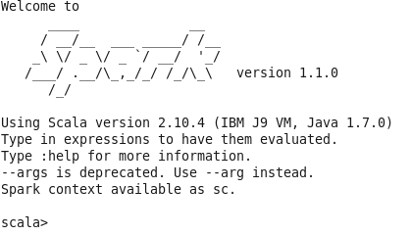
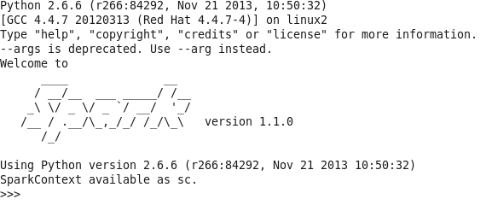
Spark Shells
Spark comes with 4 shells
Scala
Python
SparkR
SparkSQL
APIs available for Scala, Python, R, SQL, and Java
Spark’s native language is Scala, more natural to write Spark applications using Scala.
REPL – Read, Evaluate, Print and Loop

Slide 34
Invoking Spark Shell
Scala:
To launch the Scala shell (from Spark home directory):
./bin/spark-shell
To read in a text file:
scala> val textFile = sc.textFile("README.txt")
Python:
To launch the Python shell (from Spark home directory):
./bin/pyspark
To read in a text file:
>>> textFile = sc.textFile("README.txt")
SparkR:
To launch the SparkR shell (from Spark home directory): bin/sparkR
SparkSQL:
To launch the SQL CLI shell (from Spark home directory): bin/spark-sql

Slide 35
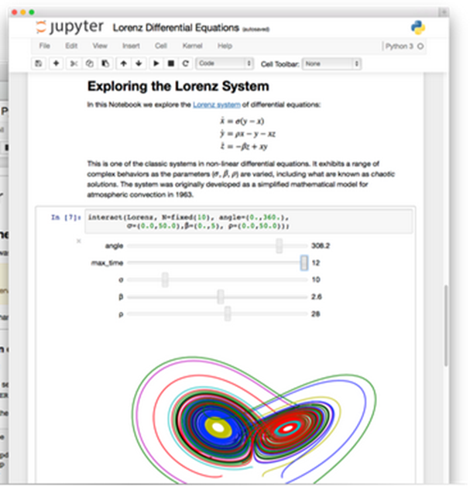
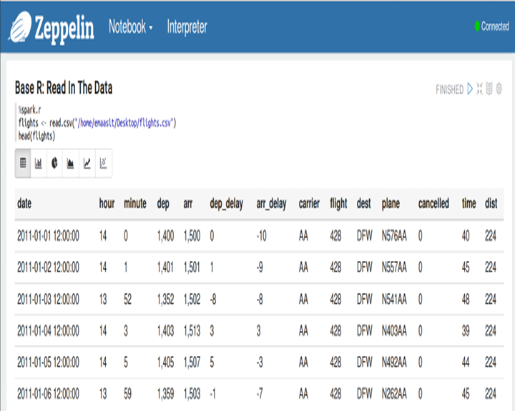
What is a notebook
Browser-based document that supports code, text, interactive visualization, math, and media.
Interactive, iterative, and collaborative work environments for programming and analytics
Living documents that are very easy to use by both technical and LOB users
Can take you from a concept to deploying an application in a single environment.
Graphical interface is bringing advanced analytics such as machine learning mainstream.

Slide 36
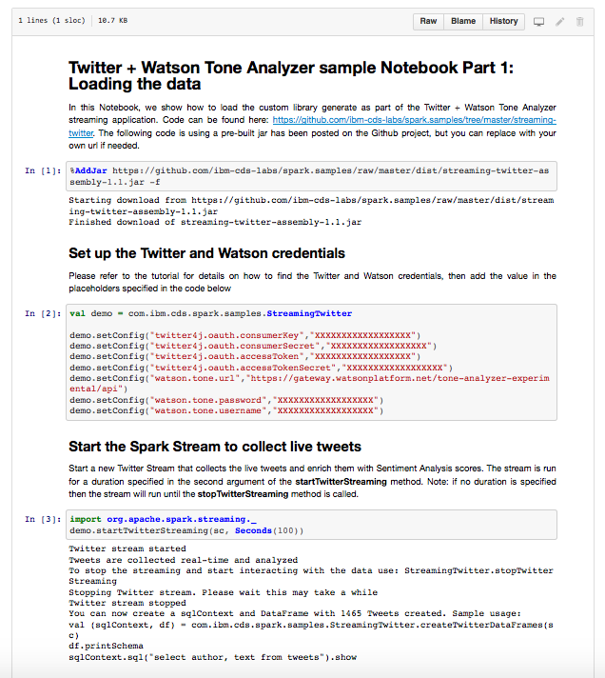
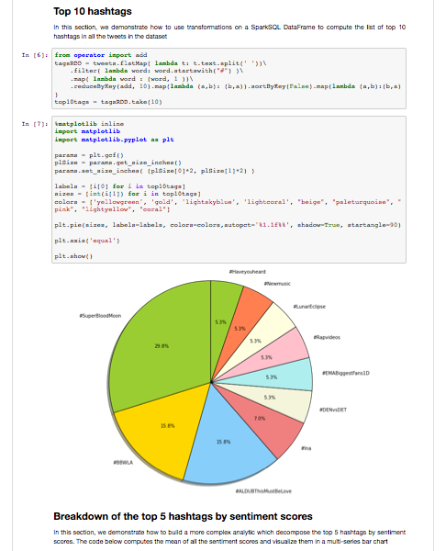
This is what a Notebook looks like

Slide 37
Spark: Final Thoughts
Spark is a good replacement for MapReduce
Higher performance
Framework makes it easier to use than MapReduce (M/R)
Powerful RDD concept
This is a very fast paced environment, so keep up !
M/R was the previous “standard”
Spark has the latest/best offer but things may change again (Flink)
Working with Spark still requires some coding knowledge
Spark success may lay in higher APIs
Such as SparkSQL, SparkR and so on

Slide 38


